Slide 1
TDP, Stream it and Lambda it
May, 2017
Notes:
A lot of companies of big size of code base might think it's too hard or too risky to upgrade to java 8. But as you fall further behind, it just becomes even harder and riskier, and eventually you end up stuck with no upgrade path. This accumulation of technical debt slows down the entire development organization so keeping our stack current is a top priority here

Slide 2
Agenda
λ Expression
Stream API in a nut shell
Optional, remedy for NPE
Adoption in TDP 4

Slide 3
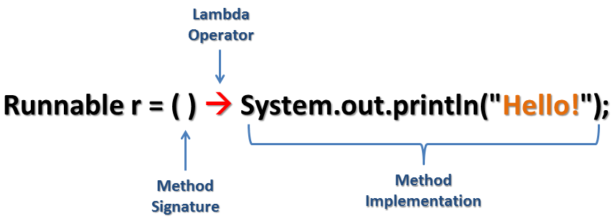
λ Expression
Notes:
lambdas as an instance of an interface type

Slide 4
λ Expression
(type1 arg1, type2 arg2...) -> { body }
(arg1, arg2...) -> { body }
Notes:
lambdas as an instance of an interface type

Slide 5
λ Expression
List<String> names = Arrays.asList(“Steve", “Thomas", “Andy", “Shaojie");
// java 7 code for (String name : names) System.out.println(name);
// java 8 code with lambda names.forEach((String name) -> System.out.println(name));
// java 8 code method reference names.forEach(System.out::println);

Slide 6
λ Expression under the hood
Collections.sort(names, new Comparator<String>() { @Override public int compare(String a, String b) { return b.compareTo(a); } });
Collections.sort(names, (String a, String b) -> b.compareTo(a)); Collections.sort(names, (a, b) -> b.compareTo(a));

Slide 7
λ Expression under the hood
Runnable runnable1 = new Runnable() { @Override public void run() { System.out.println("Hello Lambda"); } }; new Thread(runnable1).start();
Runnable runnable2 = () -> System.out.println("Hello Lambda"); new Thread(runnable2).start();

Slide 8

λ Expression
Anonymous function
Method without a declaration
Instance of a functional interface
Function is a first class citizen
Notes:
lambdas as an instance of an interface type

Slide 9
Functional Interface
Functional Interface @FunctionalInterface
Single Abstract Method (SMA) interface
Could have default method with implementation

Slide 10
Functional Interface
Examples in J2SE API?
Runnable
Callable
Comparator
Consumer
Predicate

Slide 11
Method Reference
A method reference is used to refer to a (static or instance) method without invoking it
A constructor reference is similarly used to refer to a constructor without creating a new instance of the named class or array type.
Specified with the :: (double colon) operator
Brief and clearly expressive way to implement functional interfaces

Slide 12
Method Reference Examples
Type | Example
Reference to a static method | System.out::println
Reference to an instance method of a particular object | "abc"::length
Reference to an instance method of an arbitrary object of a particular type | String[] stringArray = { "Barbara", "James", "Mary"}; Arrays.sort(stringArray, String::compareToIgnoreCase);
Reference to a constructor | ArrayList::new

Slide 13
Default Method
added for backward compatible
old interfaces can be used to leverage the lambda expression capability
‘Iterable’
forEach
‘Collection’
removeIf
stream
parallelStream

Slide 14
Multiple Defaults
interface Vehicle { default void print(){ System.out.println("I am a vehicle!"); } } interface FourWheeler { default void print(){ System.out.println("I am a four wheeler!"); } }

Slide 15
Multiple Defaults
class Car implements Vehicle, FourWheeler { public void print(){ Vehicle.super.print(); } }
class Car implements Vehicle, FourWheeler { public void print(){ System.out.println("I am a vehicle and four wheeler!"); } }

Slide 16
Final or Effectively Final
For both lambda bodies and inner classes, local variables in the enclosing context can only be referenced if they are final or effectively final.
A variable is effectively final if it is never assigned to after its initialization.
No longer need to litter code with final keyword

Slide 17
Final or Effectively Final
int zero = 0; List<Person> sortedPersons = persons.stream() .sorted((p1, p2) -> (p1.getAge() - p2.getAge() > zero ? 1 : -1)) .collect(Collectors.toList());
Effective final
int zero = 0; zero = 0; List<Person> sortedPersons = persons.stream() .sorted((p1, p2) -> (p1.getAge() - p2.getAge() > zero ? 1 : -1)) .collect(Collectors.toList());
Non effective final,compile error incur
Error:(43, 66) java: local variables referenced from a lambda expression must be final or effectively final

Slide 18

Stream

Slide 19
What is Stream
SQL-Like Operation
Declarative
Lazy evaluation
Promote immutability
Easier parallelization
Clean and concise code

Slide 20
Question?
Given a collection of Transactions : List<Transaction> transactions
Find out all transactions of type grocery
Sort them in decreasing order of transaction value
Return a list of transaction IDs : List<Integer> transactionIds

Slide 21
Solution before Java 8
// find the GROCERY type for(Transaction t: transactions){ if(t.getType() == TransactionType.GROCERY){ groceryTransactions.add(t); } }
// sort by value in descending order Collections.sort(groceryTransactions, new Comparator<Transaction>() { @Override public int compare(Transaction t1, Transaction t2) { return t2.getValue().compareTo(t1.getValue()); } });
// add to another List of Integer List<Integer> transactionIds = new ArrayList<>(); for(Transaction t: groceryTransactions){ transactionIds.add(t.getId()); }

Slide 22
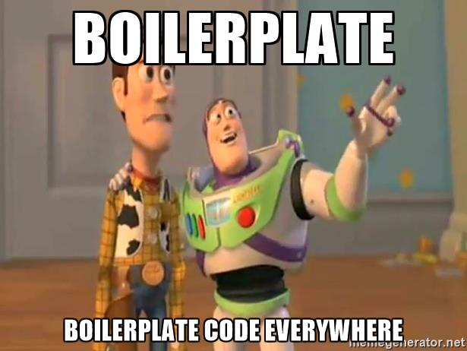
Boilerplate Code
Notes:
In my opinion Java 8 code is better because of following reasons:
Java 8 code clearly reflects developer intent of filtering, sorting, etc.
Developers express what they want to do rather than how they want do it by using a higher level abstraction in the form of the Stream API.
The Stream API provides a unified language for data processing. Now developers will have a common vocabulary when talking about data processing. When two developers talk about a filter function, you can be sure that they both are applying a data filtering operation.
No boilerplate code is required to express data processing. Developers no longer have to write explicit for loops, or create temporary collections to store data. All is taken care by the Stream API itself.
Streams do not modify your underlying collection - they are non-mutating.

Slide 23
Solution with Stream
List<Integer> transactionsIds = transactions.stream() .filter(t -> t.getType() == TransactionType.GROCERY) .sorted(comparing(Transaction::getValue).reversed()) .map(Transaction::getId) .collect(toList());

Slide 24
Solution Comparison
Old Solution with Collection | New Solution with Stream
// find the GROCERY type for(Transaction t: transactions){ if(t.getType() == TransactionType.GROCERY){ groceryTransactions.add(t); } } // sort by value in descending order Collections.sort(groceryTransactions, new Comparator<Transaction>() { @Override public int compare(Transaction t1, Transaction t2) { return t2.getValue().compareTo(t1.getValue()); } }); // add to another List of Integer List<Integer> transactionIds = new ArrayList<>(); for(Transaction t: groceryTransactions){ transactionIds.add(t.getId()); } | List<Integer> transactionsIds = transactions .stream() .filter(t -> t.getType() == TransactionType.GROCERY) .sorted(comparing (Transaction::getValue).reversed()) .map(Transaction::getId) .collect(toList());

Slide 25
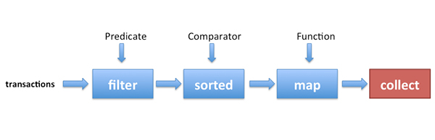
Solution with Stream

Slide 26
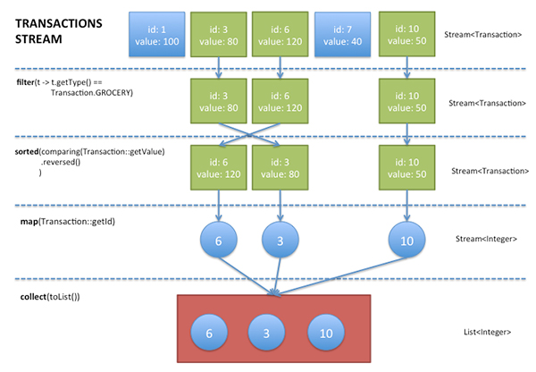
Stream
Notes:
a sequence of elements from a source that supports aggregate operations.” Streams consume from a source such as collections, arrays, or I/O resources. Streams support the common operations from functional programing languages, such as map, filter, reduce, find, sorted, etc

Slide 27
How to understand Stream
Source
Sequence of elements, arrays, collection, list, set
Flows
Intermediate operation
Aggregate operation
Pipelining
Internal iteration
Lazy evaluation
Sink
Final operation
Make the computation happen
Boss

Slide 28
Method Pipelining
Unix-like command pipelining
A pipeline is a sequence of processes
Chained together by their standard streams
Output of each process (stdout) feeds directly as input (stdin) to the next one
Each process is doing one job, and it is doing it really good
ls -l | grep key | less
ls –l | grep key | wc -l

Slide 29
Assembly Line
Notes:
a sequence of elements from a source that supports aggregate operations.” Streams consume from a source such as collections, arrays, or I/O resources. Streams support the common operations from functional programing languages, such as map, filter, reduce, find, sorted, etc

Slide 30
Stream Operations
An intermediate operation keeps a stream open for further operations. Intermediate operations are lazy.
A terminal operation must be the final operation on a stream. Once a terminal operation is invoked, the stream is consumed and is no longer usable.

Slide 31
Intermediate Operations
filter excludes all elements that don’t match a Predicate.
map performs a one-to-one transformation of elements using a Function.
sorted sort all the elements according to a the Comparable implementation of the element type or according to a Comparator

Slide 32
Terminal Operation
forEach performs an action for each element of this stream
collect performs a mutable reduction operation on the elements of this stream using a Collector
reduce performs a reduction on the elements of this stream, using the provided identity value and an associative accumulation function, and returns the reduced value

Slide 33

Bla bla bla, no more theory

Slide 34
Parallel Programming
Pure Thread Management before Java 5
Thread
Runnable
Synchronized
volatile
Taking advantage of java.util.currency package from Java 5
Executor
ExecutorService
Future
ReentrantLock
Fork/Join framework from Java 7

Slide 35
Parallel Stream
List<Integer> numbers = Arrays.asList(0,4,5,6,2,3,1,8,7,9,56,17,29); // natural sorting numbers.stream() .sorted() .forEach(System.out::println); // natural sorting in parallel numbers.parallelStream() .sorted() .forEach(System.out::println);
Notes:
Then 2 code examples will be followed

Slide 36
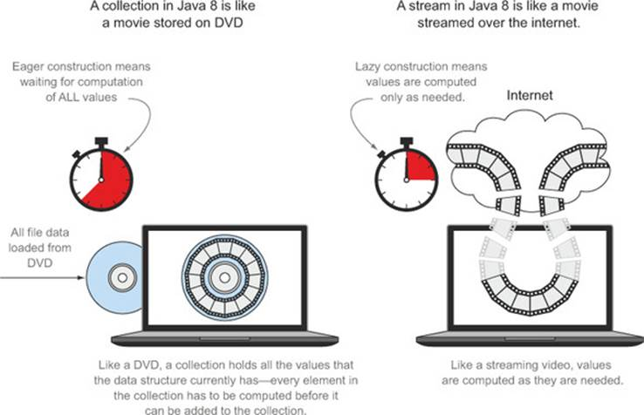
Stream vs Collection

Slide 37
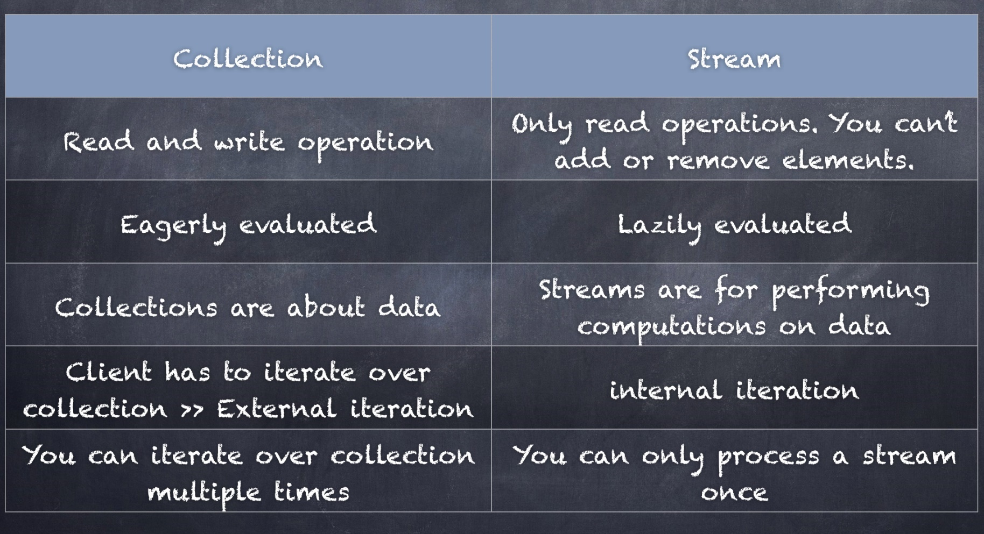
Stream vs Collection
Notes:
If you don’t want to use the steam, why do I bother computing it for you

Slide 38
Avoid Mutation
List<Person> persons = Arrays.asList( new Person("perter", 24), new Person("ian", 30), new Person("jacob", 3), new Person("angela", 28), new Person("mike", 24), new Person("steve", 60), new Person("andy", 30), new Person("jack", 15));
List<Person> sortedPersons = new ArrayList<>(); persons.stream() .sorted((p1, p2) -> (p1.getAge() - p2.getAge() > 0 ? 1 : -1)) .forEach(person -> sortedPersons.add(person));
Notes:
One of the main purposes of lambdas is use in parallel computing – which means that they’re really helpful when it comes to thread-safety.

Slide 39

Banging the head against the wall pattern

Slide 40

Mutation Anti Pattern

Slide 41

Avoid Mutation
List<Person> persons = Arrays.asList( new Person("perter", 24), new Person("ian", 30), new Person("jacob", 3), new Person("angela", 28), new Person("mike", 24), new Person("steve", 60), new Person("andy", 30), new Person("jack", 15));
//immutable sort, good practice List<Person> sortedPersons = persons.stream() .sorted((p1, p2) -> (p1.getAge() - p2.getAge() > 0 ? 1 : -1)) .collect(Collectors.toList());
//immutable sort, good practice Person[] sortedPersons = persons.stream() .sorted((p1, p2) -> (p1.getAge() - p2.getAge() > 0 ? 1 : -1)) .toArray(Person[]::new));
Notes:
Till now I have covered the stream

Slide 42
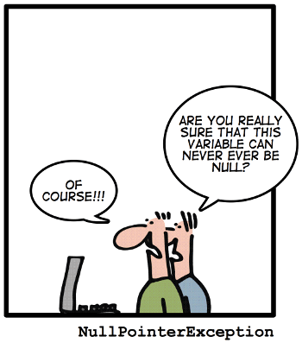
NPE

Slide 43
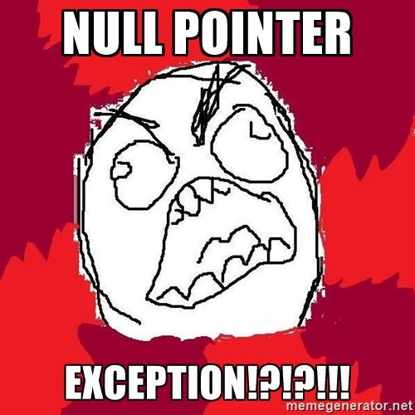
NPE? Annoying

Slide 44

NPE How to deal with it

Slide 45
Optional<T>
A container which may or may not contain a non-null value
Common methods
isPresent() – returns true if value is present
get() – returns value if present
orElse(T other) – returns value if present, or other
ifPresent(Consumer) – runs the lambda if value is present

Slide 46
Optional<T> with Value in it
// Create an instance of Optional Object
Optional<String> optionalGoal = Optional.of("goal");
// Check if there is a value in it System.out.println(optionalGoal.isPresent());
// Get the value
System.out.println(optionalGoal.get());
// If it contains no value, return fallback
System.out.println(optionalGoal.orElse("fallback"));
// Get executed only if there is value in it
optionalGoal.ifPresent((s) -> System.out.println(s.charAt(0)));

Slide 47
Optional<T> with Null
// Create an instance with NULL
Optional<String> optionalNull = Optional.ofNullable(null);
// Returns false since there is no value System.out.println(optionalNull.isPresent());
// Prints fallback since there is no value System.out.println(optionalNull.orElse("fallback"));
// no output, no NPE optionalNull.ifPresent((s) -> System.out.println(s.charAt(0)));

Slide 48
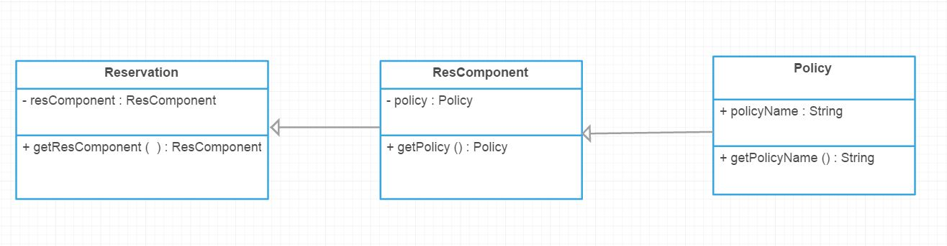
Optional<T> in TDP
Simplified TDP Reservation

Slide 49
Optional<T> in TDP
Get the Policy Name of a Reservation ? Before Java 8
if(reservation != null && reservation.getResComponent() != null && reservation.getResComponent().getPolicy() != null) {
System.out.println(reservation.getResComponent()
.getPolicy()
.getPolicyName());
}

Slide 50
Optional<T> in TDP
Get the Policy Name of a Reservation ? In Java 8
Optional.of(reservation) .map(Reservation::getResComponent) .map(ResComponent::getPolicy) .map(Policy::getPolicyName) .ifPresent(System.out::println);

Slide 51
Optional<T> Benefits
Null checks are not required.
No more NPE at run-time.
We can develop clean and neat APIs.
No more Boiler plate code.
Better readability.
Better maintainability.
Notes:
Some example where real exception needs to be thrown

Slide 52
Practice 1 in TDP
public static ResComponent getPrimaryResComponent(ResComponentGroup resCompGroup, Reservation res) { if (resCompGroup.getGroupMemberCount() > 0) { for (GroupMember groupMember : resCompGroup.getGroupMember()) { if (groupMember.hasPrimaryComponent() && groupMember.hasResComponentSequence()) { ResComponent resComp = ResComponentUtil.getResComponent(res,
groupMember.getResComponentSequence()); if (resComp != null) { return resComp; } } } } return null; }

Slide 53
Practice 1 in TDP
Improved by using λ, Stream and Optional
public static ResComponent getPrimaryResComponent(ResComponentGroup resCompGroup, Reservation res) { return Arrays.stream(resCompGroup.getGroupMember()) .filter(gm -> gm.hasPrimaryComponent() && gm.hasResComponentSequence()) .map(gm -> ResComponentUtil.getResComponent(res, gm.getResComponentSequence())) .findFirst() .orElse(null); }

Slide 54
Practice 2 in TDP
private static List<String> getAllPolicyCodeWithResComSequence1BeforeJava8(List<Reservation> reservations)
{ List<String> policyCodes = new ArrayList<>(); for(Reservation reservation : reservations){ for(ResComponent resComponent : reservation.getResComponents()) if (resComponent.getSequence() == 1) { for (Policy policy : resComponent.getPolicies()) { if(policy.getPolicyCode() != null) policyCodes.add(policy.getPolicyCode()); } } } return policyCodes; }

Slide 55
Practice 2 in TDP
Improved by using λ, Stream and Optional
public static List<String> getAllPolicyCodeWithResComSequence1InJava8(List<Reservation> reservations)
{ return reservations .stream() // .parallel() .map(reservation -> reservation.getResComponents()) .flatMap(Collection::stream) .filter(resComponent -> resComponent.getSequence() == 1) .map(resComponent -> resComponent.getPolicies()) .flatMap(Collection::stream) .map(Policy::getPolicyCode) .collect(toList()); }

Slide 56
Practice 3 in TDP
Valida the reservation in request, in case there is no policy code in rescomponent, throw an AnyException
private static String validateAnyPolicyCodeInJava8(List<Reservation> reservations) { return reservations.stream() .map(reservation -> reservation.getResComponents()) .flatMap(Collection::stream) .map(resComponent -> resComponent.getPolicies()) .flatMap(Collection::stream) .map(Policy::getPolicyCode) .findAny() .orElseThrow(() -> new AnyException("there is no policy code")); }

Slide 57

More Enjoyable!

Slide 58


